Slide 1
Future Breast Cancer risk prediction
Xin Wang

Slide 2
Sung et al, CA: A Cancer Journal for Clinicians, 2021.
Breast Cancer：
The risk of a woman developing breast cancer: 10-13%
2.3 million new cases, 24.5% of all cancers
Leading cause of cancer death in women, about 16%.
5-year survival rate 99% for patients with stage I breast caner, 28% for patients with stage IV (metastatic)
Incidence (Females)
Mortality (Females)
Figure 1. Incidence and mortality for different cancers in 2020.
2

Slide 3
ACS Breast Cancer Screening Guidelines
Breast Cancer Screening Program
Aim: To reduce the mortality rate by finding the cancer at an early stage when it can be treated and may be cured. Early detection often offers more options in terms of the available treatment methods and treatment is most likely to be successful.
Breast Cancer Screening Guidelines
Women at average risk:
Women between 40 and 44 have the option to start screening with a mammogram every year.
Women 45 to 54 should get mammograms every year.
Women 55 and older can switch to a mammogram every other year, or they can choose to continue yearly mammograms. Screening should continue as long as a woman is in good health and is expected to live at least 10 more years.
Women who are at high risk for breast cancer based on certain factors should get a breast MRI and a mammogram every year, typically starting at age 30.

Slide 4
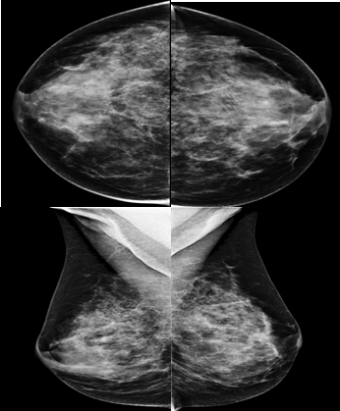
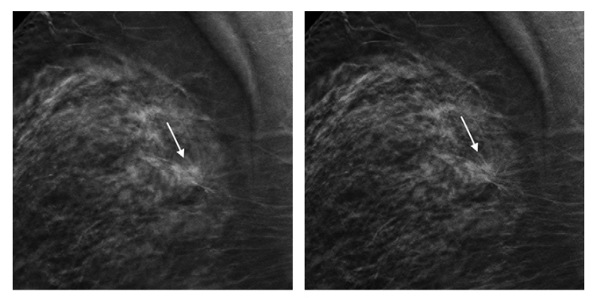
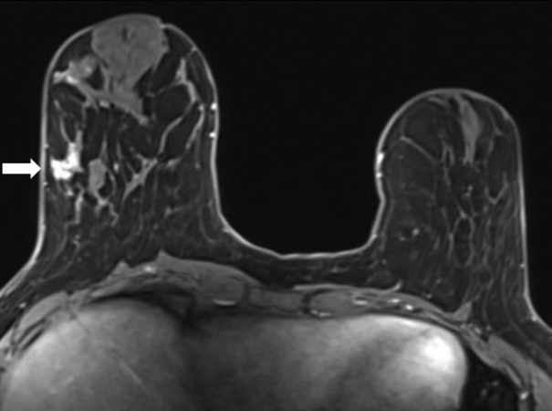
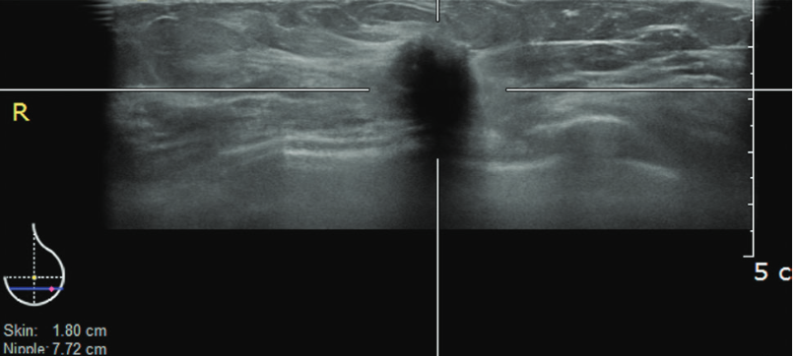
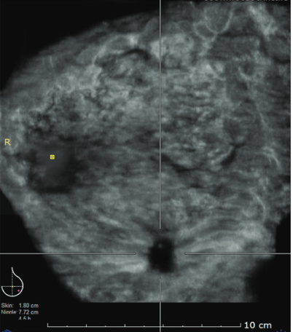
Mann R M, et al. Radiology, 2020.
Breast Cancer Screening Imaging
Mammography (MG): The most common screening test for breast cancer.
Only imaging modality that has been proven to decrease mortality from breast cancer
Lower sensitivity with dense breast tissue
Digital breast tomosynthesis (DBT): A newer type of mammogram.
Increase breast cancer detection rate and can be helpful in women with more dense breasts
Cost more than 2D mammograms
Magnetic resonance imaging (MRI): Supplemental Screening for high risk population.
Can be helpful in women with more dense breasts
Breast MRIs may appear abnormal even when there is no cancer
Ultrasound (US): Supplemental Screening for high risk population
For the women who can not have MRI
High false-positive rates

Slide 5
Advantages of the Breast Cancer Screening
Health gain
Risk reduction
Less invasive treatment due to early detection
More treatment options due to early detection
Disadvantages of the Breast Cancer Screening
False-positive results
Overdiagnosis and overtreatment
False-negative results
No guarantees; the programme fails to detect 3 in 10 cases of breast cancer.
Radiation / tests in healthy people
Mammography is a painful method
Cost
Q: How to balance the Benefit and Harm ?
A: Personalized strategies
based on risk level

Slide 6
BC Risk Prediction
Aims: Identify high risk individuals who would benefit from early and supplemental methods of screening, genetic testing, and/or preventive therapies, in addition to helping the general population make educated decisions about screening.
Guide personalized screening
Prevention recommendations
Earlier detection with less screening harm
Task: Estimate the probability of future breast cancer incidence within a specified time period.
Related Method:
Traditional Method: Risk Factors Based (BCSC, Tyrer-Cuzick, BCRAT)
Deep Learning Method: Image Based / Image and Risk Factor Based (SOTA Mammogram based: MIRAI 5 year risk)
Potential to benefit a wide patient population

Slide 7
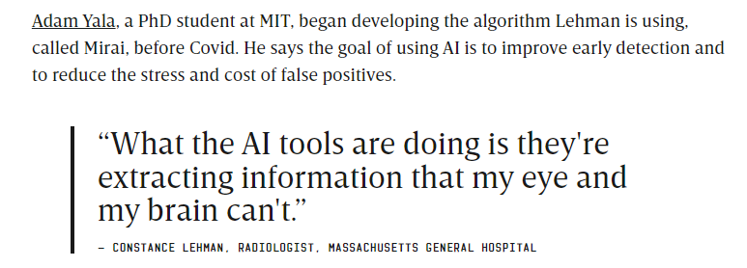
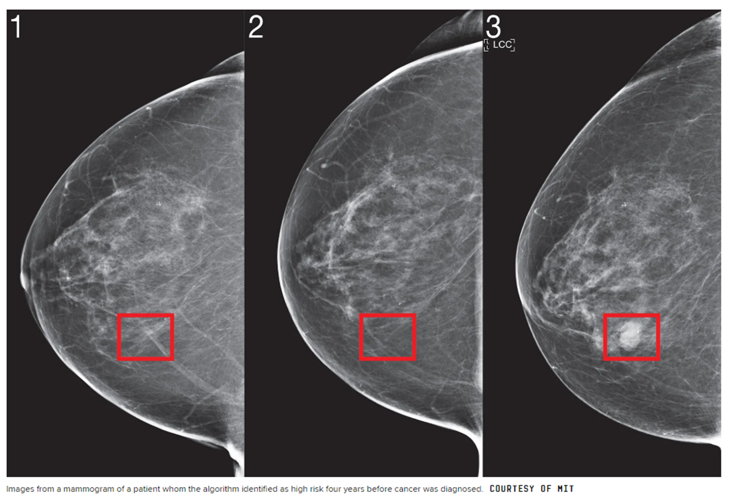
Form: https://www.wired.com/story/doctors-using-ai-screen-breast-cancer/

Slide 8
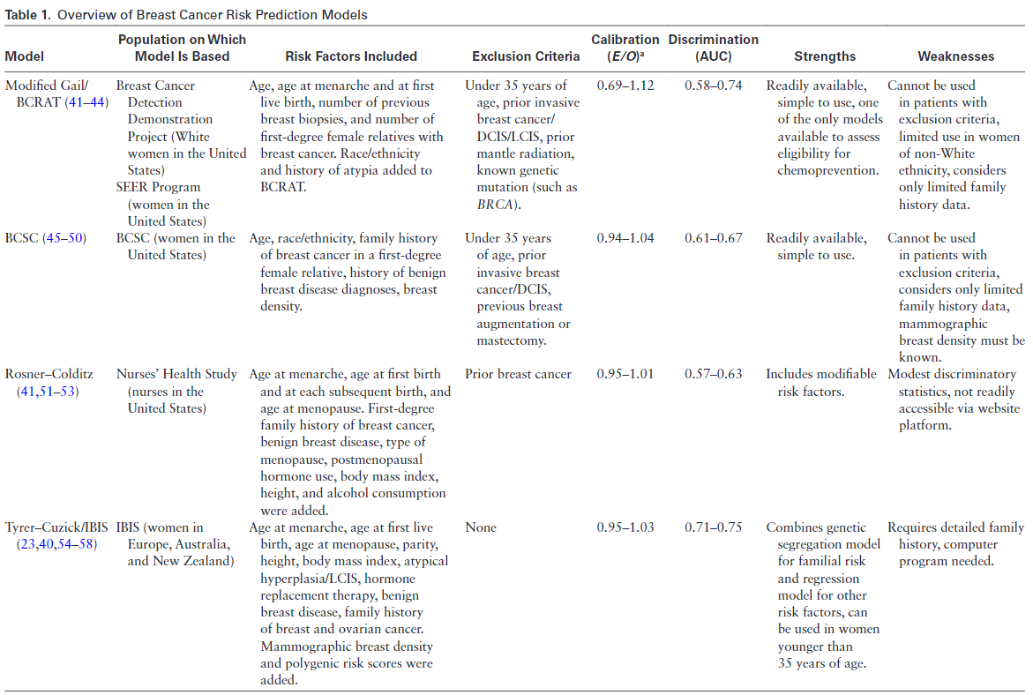
Kim G , et al. Journal of breast imaging, 2021.
Traditional Risk Models – Based on Risk Factors
Reproductive and hormonal risk factors:
Age
Age at first live birth and at menopause
Age at menarche
Breast density
Genetic factors
Family history,
High-risk genetic mutations (BRCA1/2)
Benign breast disease and prior biopsy
Proliferative disease with atypia
Radiation exposure
Lifestyle factors
BMI
High levels of alcohol in-take

Slide 9
Gastounioti A, et al. Breast Cancer Research, 2022.
Mammogram Based Deep Learning Risk Models
Mammographic images contain risk indicators beyond breast density that may not be perceptible by humans
Computational mammographic phenotypes have demonstrated a promising role in breast cancer risk prediction
Breast Cancer Risk Model
Future BC Risk
Risk Factors

Slide 10
Image Based Deep Learning Model
Traditional BC Risk Model
0 - 3 Month
3 Month - 2 Year
2 Year – 5 year
10y or Longer
Now
Future
Extremely short term risk
(Malignancy Risk)
Short term risk
Middle term risk
Long term risk
Cancer Detection task
Mainly Focus on the last three risk
Figure 1. Breast Cancer Risk Prediction

Slide 11
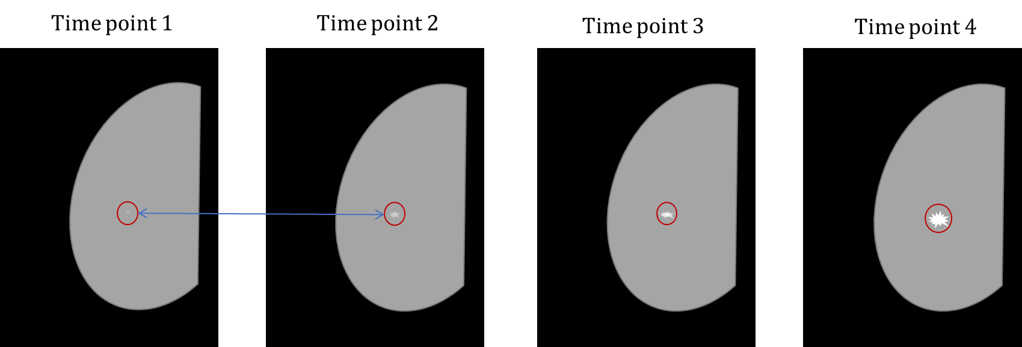
Predicting long term breast cancer risk using longitudinal mammographic screening history | medRxiv.
Motivation: Instead of learning risk features from single-time point imaging, multi-time point learning may helpful for discovering the underlying risk pattern of dynamic breast cancer development.
Figure 1. Looking for Developing Asymmetry form the multi-time point exams

Slide 12
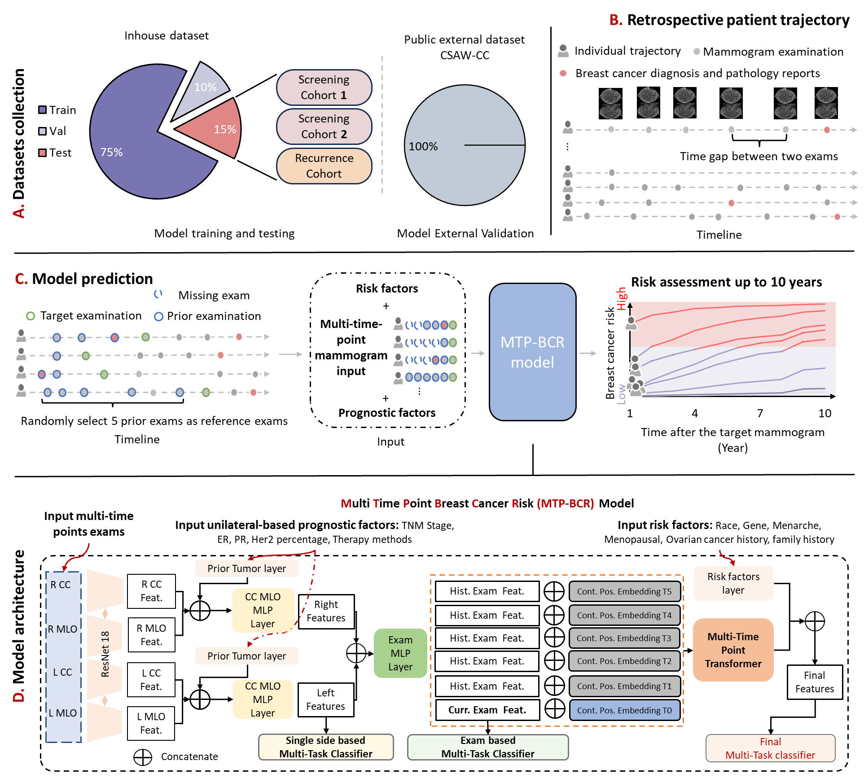
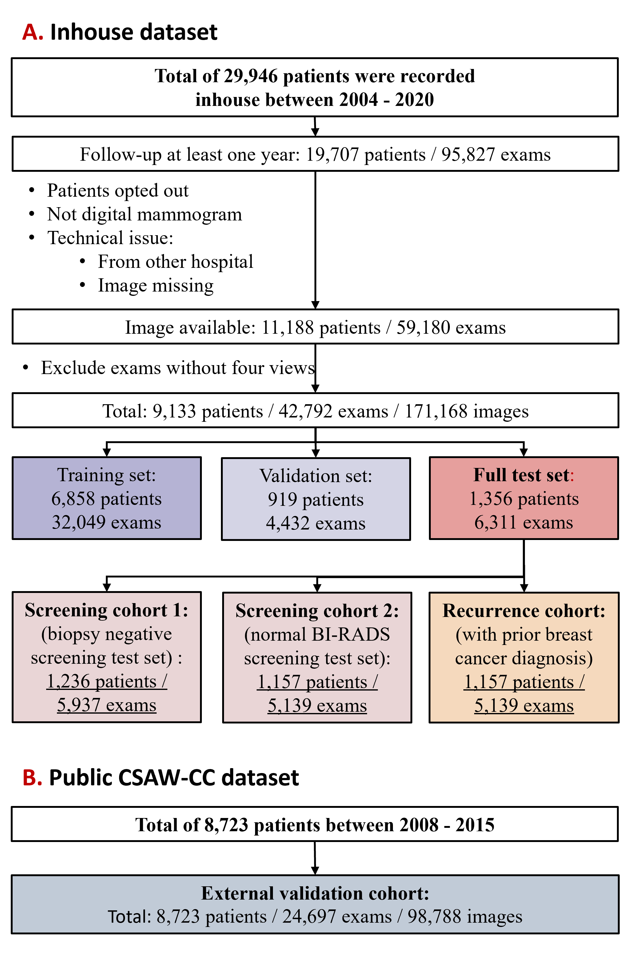
Predicting long term breast cancer risk using longitudinal mammographic screening history | medRxiv.
Figure 1. Overview of study design
Figure 2. The flowchart of dataset collection

Slide 13
Predicting long term breast cancer risk using longitudinal mammographic screening history | medRxiv.
Table 1. Characteristics of participants for the inhouse dataset
Table 2. Characteristics of participants for the CSAW-CC dataset
Table 3. Number of examinations per cancer type in the Inhouse dataset

Slide 14
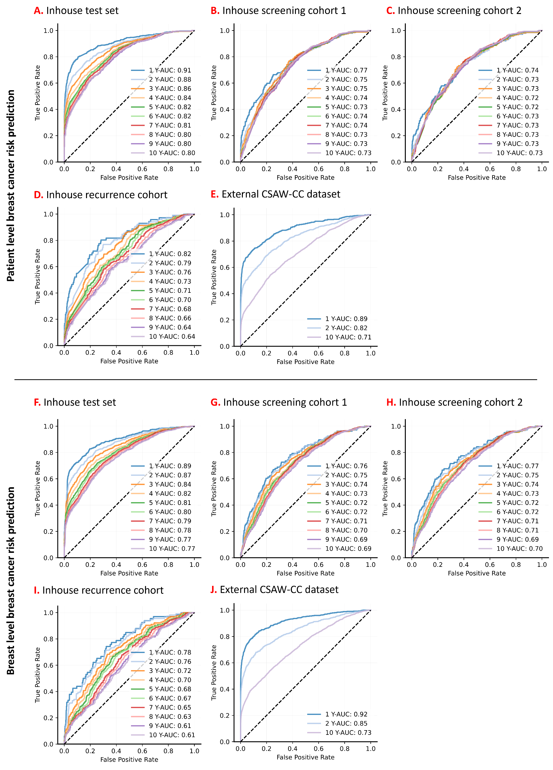
Predicting long term breast cancer risk using longitudinal mammographic screening history | medRxiv.
Figure 1. ROCs for MTP-BCR model prediction base on exam-level.
Figure 2. ROCs for MTP-BCR model prediction base on breast-level.

Slide 15
Table 1. Ablation studies on 10-year risk dataset. C-index and AUC results are presented with 95% Confidence Interval. Exam Based: baseline method uses multi-view mammograms (Right/Left; CC/MLO) to predicate breast cancer risk. Multi-Task: multi-task prediction of breast cancer risk and auxiliary tasks (e.g. age, BIRADS, and breast density). Multi-Level: using side-based and exam-based classifiers derived from Side-Specific Prediction Module and Exam-Based Prediction Module. Multi-Time-Point: using multi-time points exams. Use risk factors: input risk factors (race, gene, menarche, menopausal, personal ovarian cancer history, and family history) and prior tumor information and also more auxiliary tasks learning (personal breast cancer history; future cancer subtype and location).
Table 2. Comparison of BCR-MTP method for 10-year risk predictions using different numbers of time point exams on the full inhouse test set. C-index and AUC results are presented with 95% Confidence Interval.

Slide 16
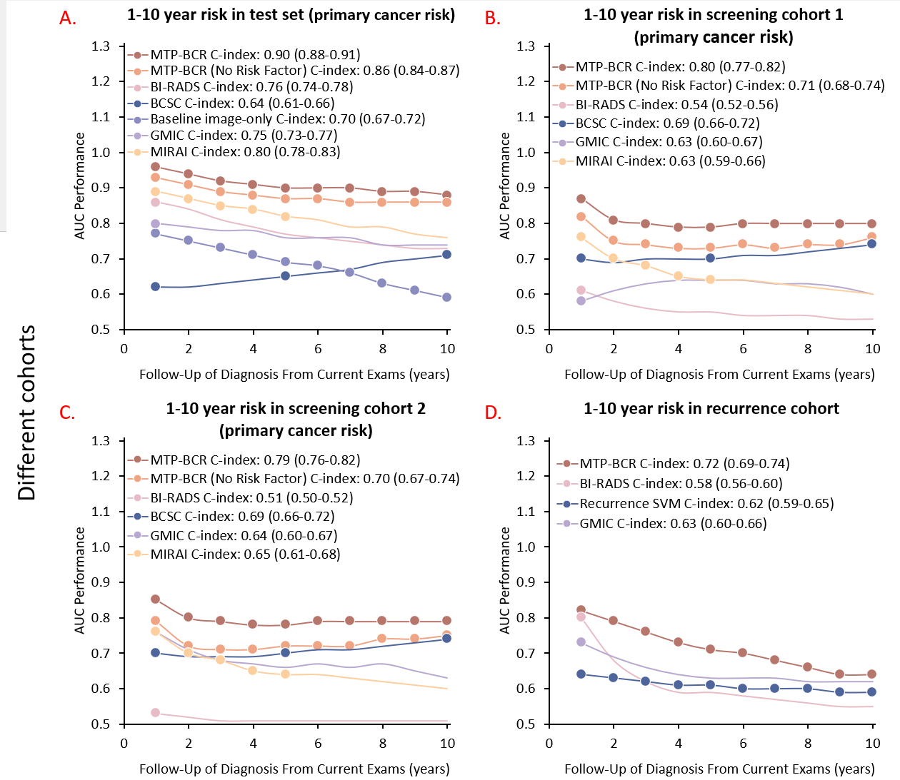
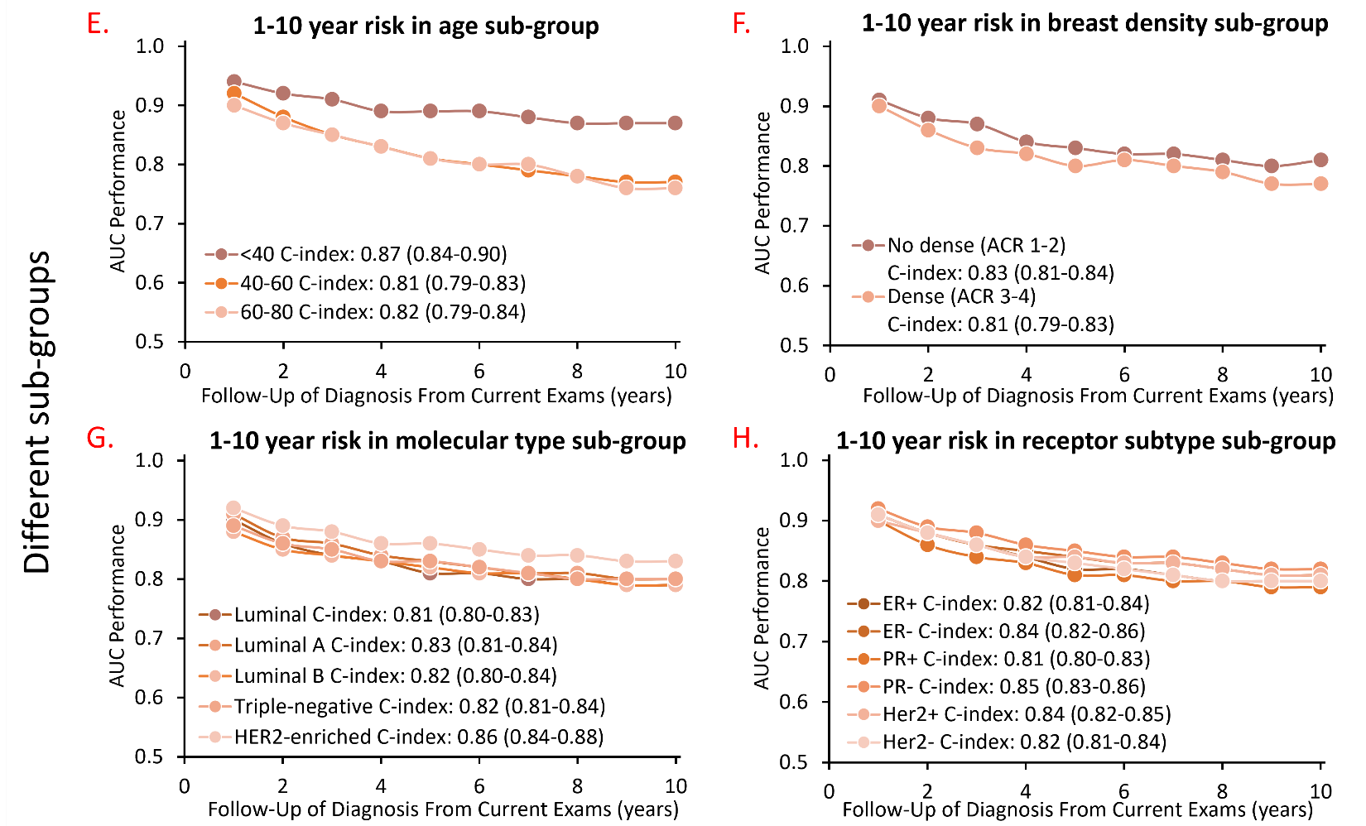
Predicting long term breast cancer risk using longitudinal mammographic screening history | medRxiv.
Figure 2. Subgroup analysis
Figure 1. Comparison results on different cohorts.

Slide 17
Fig. 5. Kaplan–Meier (KM) curves for 10-year risk stratifying by different methods on primary screening cohort2. For groups are divided by the predicted risk scores of each model, including 1) 0 to 10th percentile, 2) 10th to 50th percentile, 3) 50th to 90th percentile and 4) 90th and up.

Slide 18
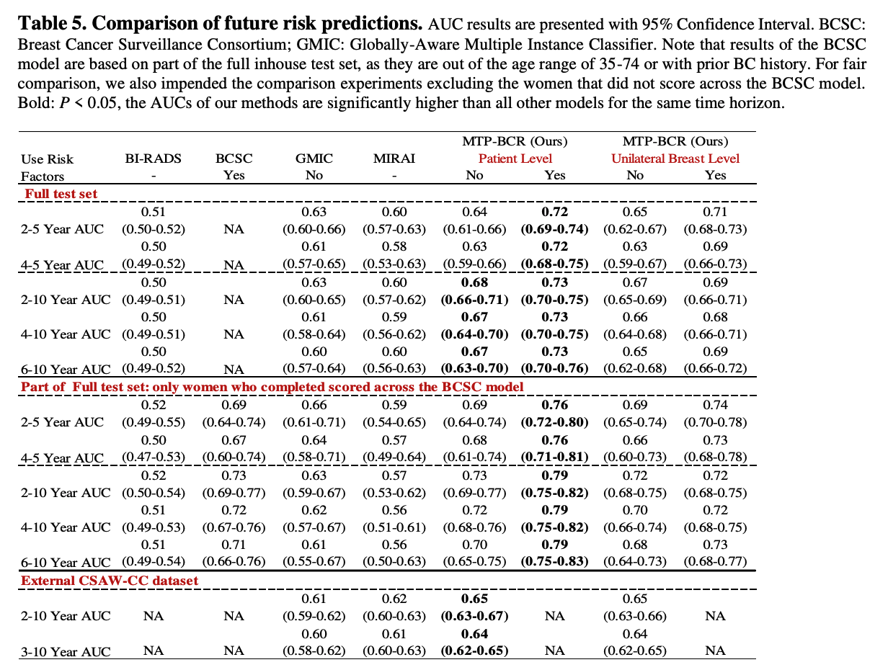
Predicting long term breast cancer risk using longitudinal mammographic screening history | medRxiv.

Slide 19
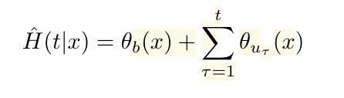
Previous Methods of Risk Prediction
Ordinal Learning: Longitudinal Attention Alignment Model for Predicting Time to Future Breast Cancer Events from Mammograms.
Risk Prediction
Binary Classification
Multi-Binary classification
Cumulative hazard-based method
Time to BC Prediction
1. Regression
They make use of two additional fully connected layers to calculate base hazard θb and time-dependent hazard θu, respectively.

Slide 20
Thanks !

